Slide 1
All ABOARD the Data Science Train: Predicting Long-Term Boardgame Success With Kickstarter and BoardGameGeek Data
March 13, 2020
Miguel Martin Menez
General Assembly - DSI-10-DC
Instructors: Adi Bronshtein, Chuck Dye

Slide 2
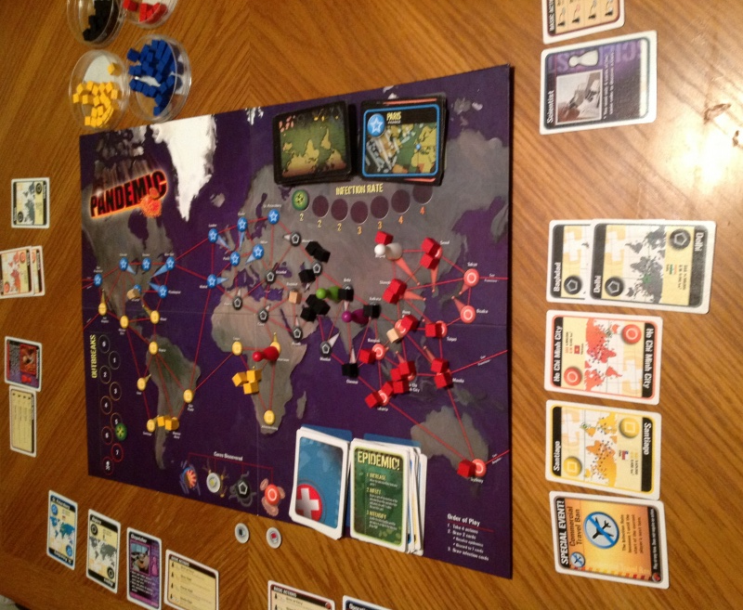

Slide 3
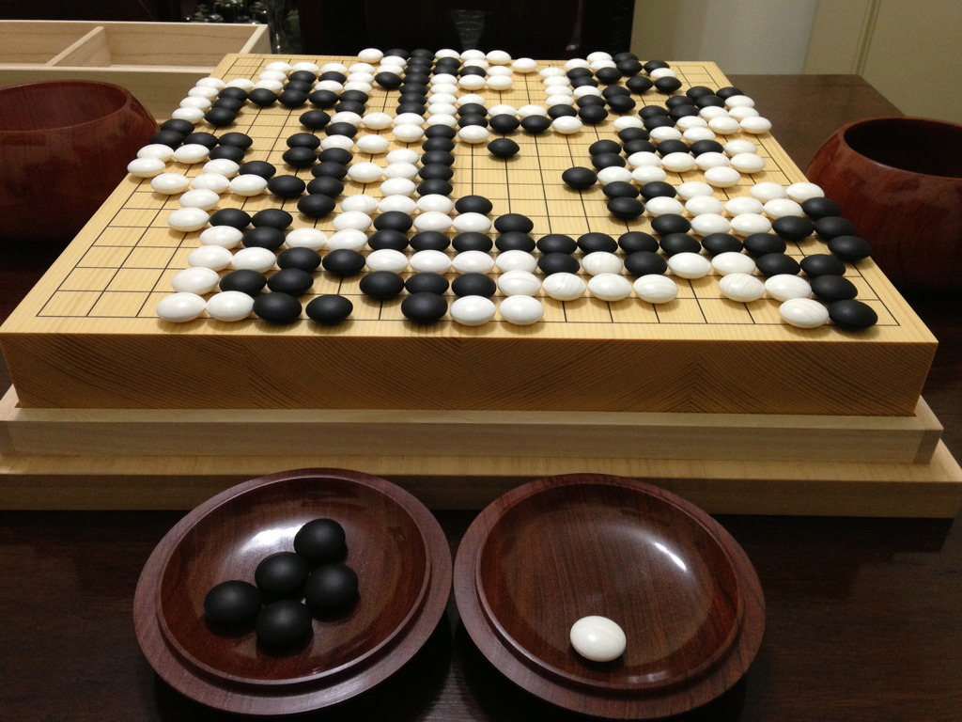

Slide 4

“Kickstarter campaigns make ideas into reality. It’s where creators share new visions for creative work with the communities that will come together to fund them.
Some of these creators, like Critical Role, TLC, and The Smithsonian Institution already had huge fanbases. But many projects have been as small-scale as a limited run of silent meditation vinyls or as up-and-coming as early versions of Issa Rae's Insecure and Phoebe Waller-Bridge’s Fleabag.”
https://www.kickstarter.com/about?ref=global-footer

Slide 5
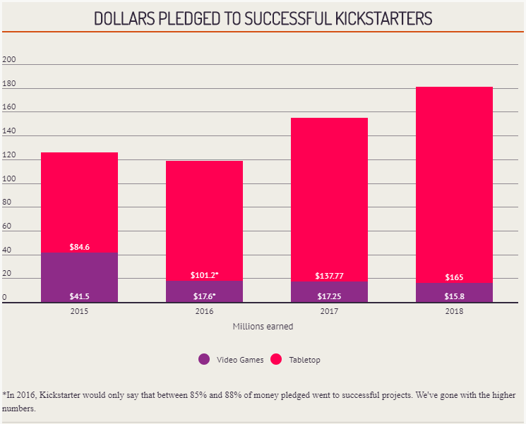
Kickstarter (KS) has raised 4.56 billion USD as of Oct. 2019
Tabletop Game Kickstarters made up at least $600 million of that (13%)
As of school year (SY) 2016-17, Statewide SAT Testing (SST) was adopted by Colorado and Illinois.
The first tests were taken in the Spring of 2017.
https://www.polygon.com/2019/1/15/18184108/kickstarter-2018-stats-tabletop-video-games

Slide 6
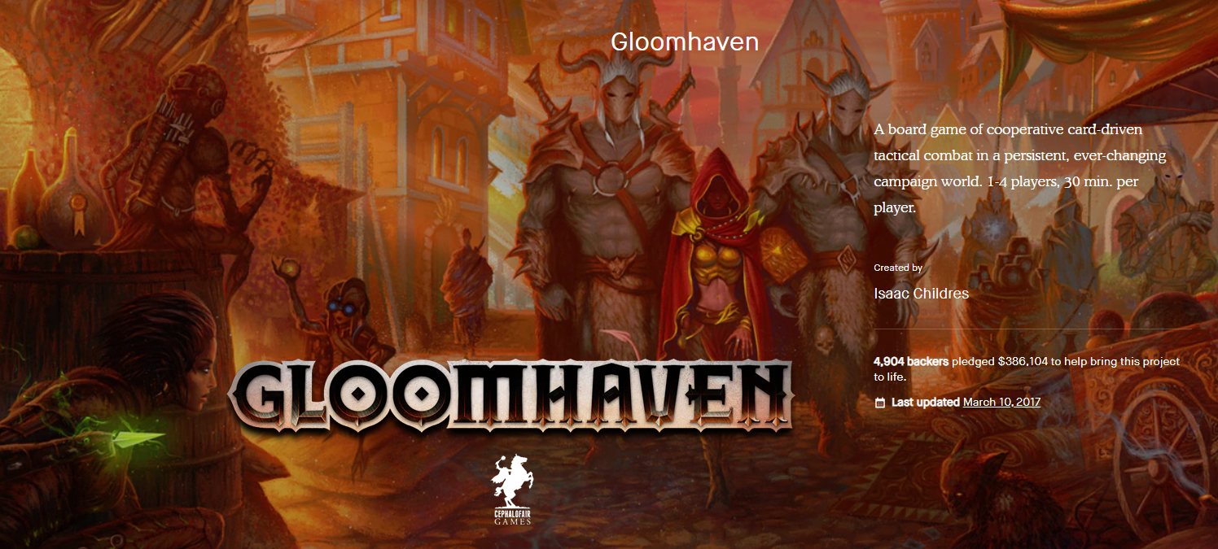
https://www.kickstarter.com/projects/frosthaven/gloomhaven

Slide 7
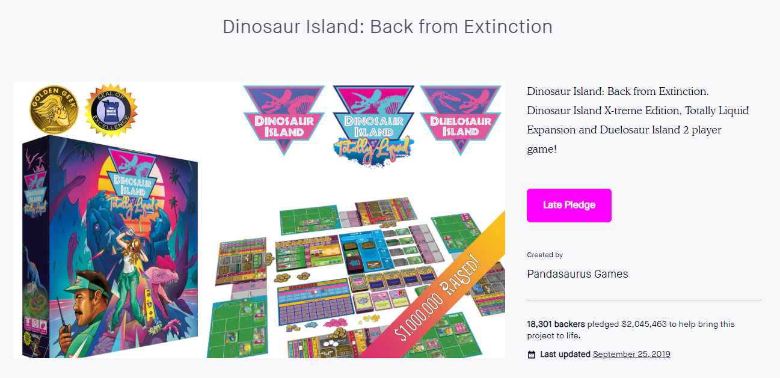
https://www.kickstarter.com/projects/pandasaurus/dinosaur-island-back-from-extinction

Slide 8
What combination of features help predict the long-term success of a Kickstarted Board Game, measured by it landing in the top 2000 (top ~10%) games on BoardGameGeek?

Slide 9

“Gaming Unplugged Since 2000 BoardGameGeek is an online board gaming resource and community. The site is updated on a real-time basis by its large and still growing user base, making the 'Geek the largest and most up-to-date place to get gaming information! ”

Slide 10
Data Collection:
2015 - 2018 Kickstarter Data from Web Robots
27 gb of data
2017-2018 BoardGameGeek data from Kaggle
Scraping BGG is great for personal use

Slide 11
Data Assembly - Factors Under Your Control
Categories
Mechanics
KS and BGG Features
Theme - what a game is about: sci-fi, farming, murder/mystery, fantasy, zombies.
Key components - dice, miniatures.
Rules - how you play the game:
Dice rolling
Role playing
Worker Placement
BoardGameGeek:
Weight / Complexity
Average game time
Kickstarter:
Pledge goal
Pledge amount

Slide 12
Categories
Mechanics
Miniatures
Negotiation
Zombies
Puzzle
Civilization
Murder / Mystery
Fantasy
Economic
Variable Player Powers
Worker Placement
Action Points
Voting
Simulation
Variable Phase Order
Area Movement
Hex and Counter

Slide 13
KS and BGG Features
Final Features
Weight / Complexity
Average Time
Funding Goal
Miniatures
Negotiation
Zombies
Variable Player Powers
Worker Placement
Action Points
Weight / Complexity
Average Time
Funding Goal

Slide 14
Results and Recommendations
Logistic Regression: 67% / 65% vs.
Baseline of 42%
Minis? Yes.
Get more recent BGG and KS data
Get board game sales data to better represent long-term success.

Slide 15
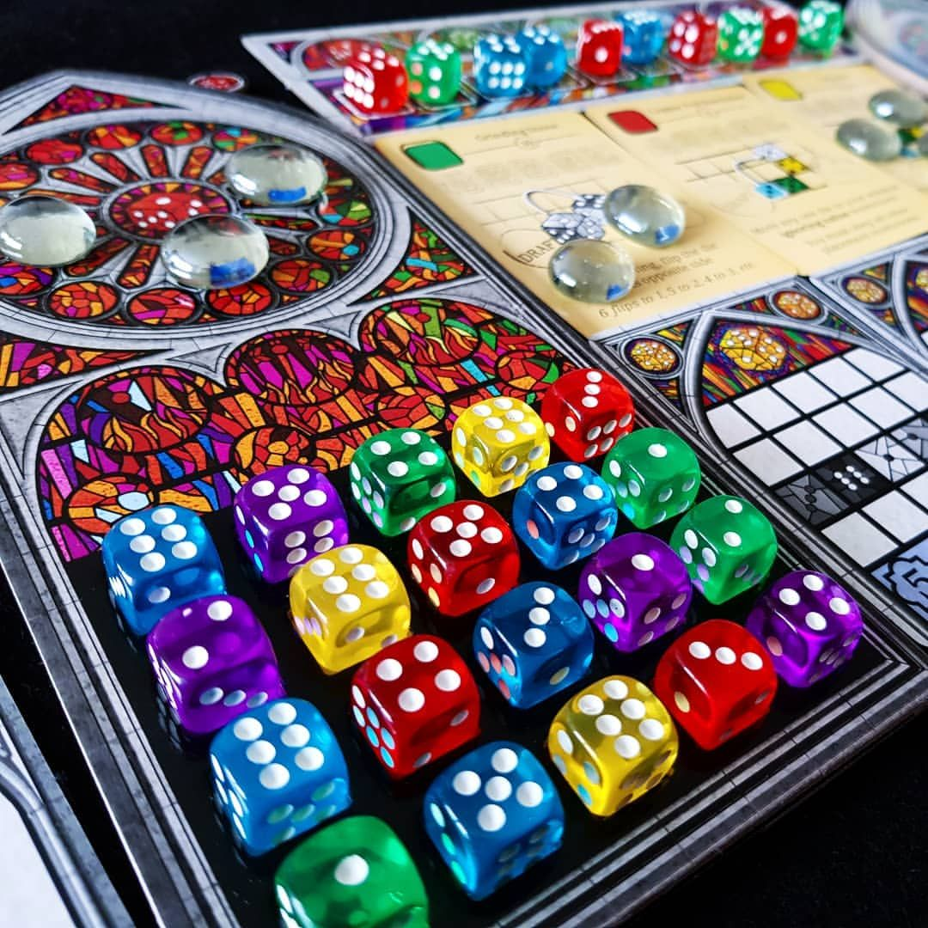
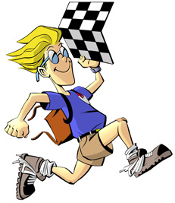
Ethical Considerations
Representation of Data - BGG 2018 Poll:
87.6% Male / 11% Female
67% between 26 and 45
56% from the United States
Board Games as Art
A beautiful combination of rules, artwork, and interpersonal interaction that produce unique experiences and memories.
Image from BoardgamerBros on Instagram: https://www.instagram.com/p/BgCd26MgAxh/

Slide 16

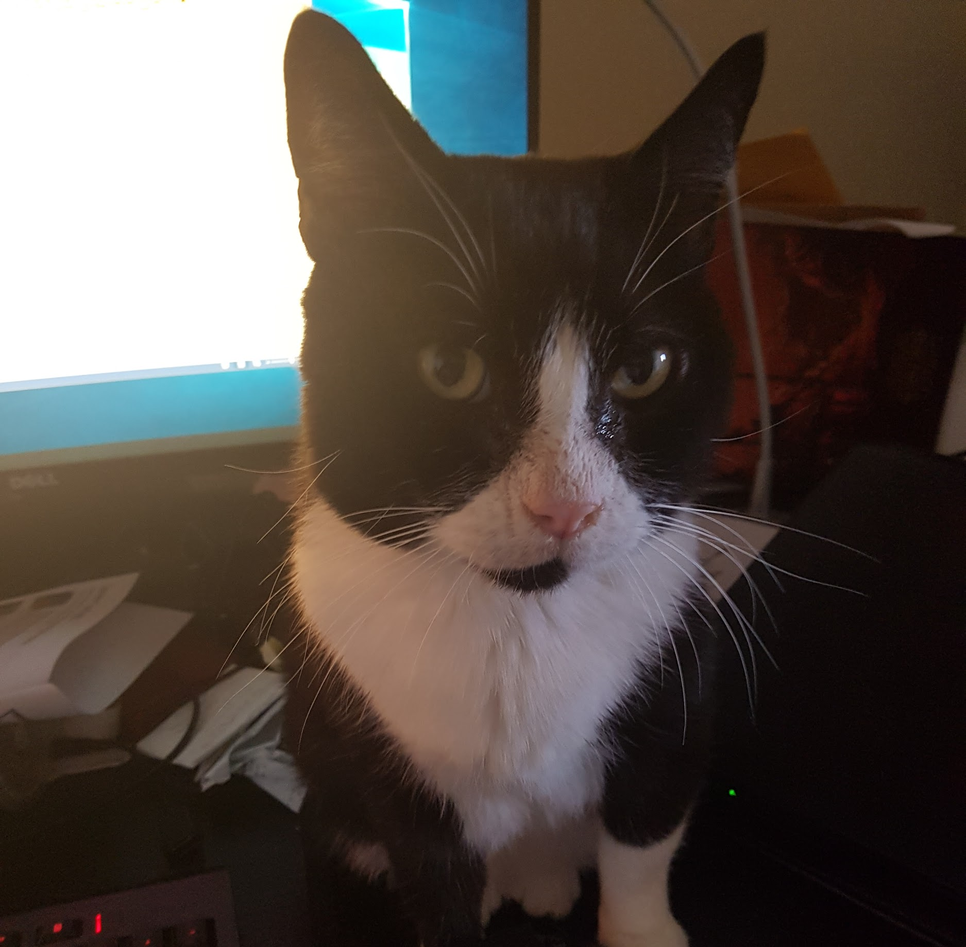
The Team
Miguel Martin Menez Data Scientist
Edward
CFO
Call me: 973-626-9878
Reach me: miguelmmenez@gmail.com
Beep me: linkedin.com/in/mmmenez
kibbles pls

Slide 17
